Slide 1
Epistatic Genetic Architectures Evolutionary Implications
José M Álvarez-Castro

Slide 2
Outline
Genetic effects (review)
Nomenclature issues
Genetic effects and regression towards mediocrity
Epistasis
Models of genetic effects with epistasis
Estimation of genetic effects with epistasis
Evolutionary importance of interactions
Variance components
Interpretation of genetic effects in mapping experiments
Perspective: Evolutionary Quantitative Genetics

Slide 3
Nomenclature issues
What is a “gene frequency”?
What is the “effect of a gene”?
When is a trait “additive”?
Why are there genetic effects related and unrelated to populations?
What does the “heritability” of a trait depend upon?

Slide 4
Gene or allele frequencies?
Gene frequencies are often used as synonyms of allele frequencies
However, the meaning of the words “gene frequencies” actually evokes the proportion of individuals in a population having a gene (as opposed to a gene variant)
Such uses of words can get to be extremely confusing in evolutionary biology, especially for students
Something similar occurs with the “effect of a gene”, which is used to talk about differential effects of alleles within a gene (rather than about knock outs)

Slide 5
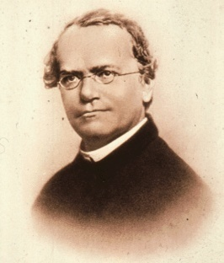
Additive and interaction effects
Here we use the well-known, simple case of Mendel’s peas to introduce the concept of additive and interaction effects (in the individual-referenced context)
Genotype
Phenotype
Effects
A₁A₁
0
R = 0
A₁A₂
1
R + a + d = 1 => d = ½
A₂A₂
1
R + 2 a = 1 => a = ½
This way we have re-parameterized the genotypic values into (additive and dominance) genetic effects measured from the reference of one individual genotype

Slide 6
Additive and interaction effects
For Mendel, dominance was important because it obscured (in the phenotypes) the proportions of the inheritance factors
We also are interested in evolutionary predictions:
Selection of high phenotypes:
d = 0, fixation
Phenotype
G
1
2a
a
0
0
1
2
A₁A₁
A₁A₂
A₂A₂
Genotype

Slide 7
Additive and interaction effects
For Mendel, dominance was important because it obscured (in the phenotypes) the proportions of the inheritance factors
We also are interested in evolutionary predictions:
Selection of high phenotypes:
d = 0, fixation
d = a, slower fixation
Phenotype
G
1
d
2a
a
0
0
1
2
A₁A₁
A₁A₂
A₂A₂
Genotype

Slide 8
Additive and interaction effects
For Mendel, dominance was important because it obscured (in the phenotypes) the proportions of the inheritance factors
We also are interested in evolutionary predictions:
Selection of high phenotypes:
d = 0, fixation
d = a, slower fixation
d > a, no fixation
Phenotype
G
1
d
2a
a
0
0
1
2
A₁A₁
A₁A₂
A₂A₂
Genotype

Slide 9
Additive and interaction effects
For Mendel, dominance was important because it obscured (in the phenotypes) the proportions of the inheritance factors
We also are interested in evolutionary predictions:
Selection of high phenotypes:
d = 0, fixation
d = a, slower fixation
d > a, no fixation
d = -a, faster fixation
Phenotype
G
1
2a
d
a
0
0
1
2
A₁A₁
A₁A₂
A₂A₂
Genotype

Slide 10
Additive and interaction effects
For Mendel, dominance was important because it obscured (in the phenotypes) the proportions of the inheritance factors
We also are interested in evolutionary predictions:
Selection of high phenotypes:
d = 0, fixation
d = a, slower fixation
d > a, no fixation
d = -a, faster fixation
d < -a, two fixation points
With multiple alleles, epistasis genotypic values would not be feasible to track (need of effects)
Phenotype
G
1
2a
a
0
d
0
1
2
A₁A₁
A₁A₂
A₂A₂
Genotype

Slide 11
Simple maths: Matrix notation
G = S_{R1} E_{R1}
This enables straightforward inversion and change of reference:
Effects from genotypic values:
From any reference point:
Change of reference equating G: E_{R2} = (S_{R2})⁻¹ S_{R1} E_{R1}
Álvarez-Castro and Carlborg 2007 Genetics 176
Notes:
Notice that the expression of S^-1 from any reference point does not make the genetic effects change when changing the reference

Slide 12
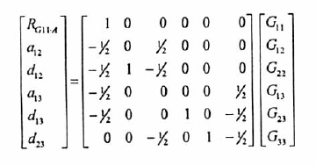
Multiple alleles
The matrices for several alleles can also be built easily, although each new allele brings more genetic effects to the genetic system
All these expressions are 21st century genetic modelling (NOIA)
Question: Given that the (non population-related) genetic effects are biologically meaningful, why were they considered just as a yardstick?
Yang and Álvarez-Castro 2008 CurrTopGen 3 Álvarez-Castro and Yang 2011 Genetica 139

Slide 13
Decomposition of the genotypic values
G is a vector gathering the genotypic values (expected phenotype of each genotype) and it is called the Genotype-to-Phenotype (GP) map
The re-parameterization of the genotypic values into genetic effects G=SE can also be explained as a decomposition of the genotypic values into genetic effects: G_{ij} = R + a_{ij} + d_{ij}
Each genotypic value is now expressed as additive and interaction effects in the context of a reference point
Thus G = A + D, and hence P = G + E = A + D + E
With several loci, epistasis should also be added

Slide 14
Biological interpretation
The individual-referenced genetic effects are the effects of allele substitutions—rather than genes or alleles—from the reference of an individual genotype
They are decomposed into effects that just add up when making the substitutions and effects that comprise the departures from the additive expectations
Those departures are interactions that matter for the outcome of selection on the trait—in our example, the dominance effect being equal to the additive effect indicates complete dominance
The choice of the reference individual may or may not be arbitrary—it can be the common ancestral genotype from which mutations arose or rare alleles increased in frequency

Slide 15
Graphical interpretation
G₁₂
G₂₂
α₂₂
1
1
α₁₂
d
α₁₁
2α
Genotypic value
2a
Genotypic value
G₁₁
a
δ₁₁
0
0
0
1
2
0
1
2
A₁A₁
A₁A₂
A₂A₂
A₁A₁
A₁A₂
A₂A₂
Genotype
Genotype
Individual-referenced genetic effects
Population-referenced genetic effects
Kliman (Ed.) 2016 Encyclopedia of Evolutionary Biology. Vol 2 Quantitative Genetics. Elsevier

Slide 16
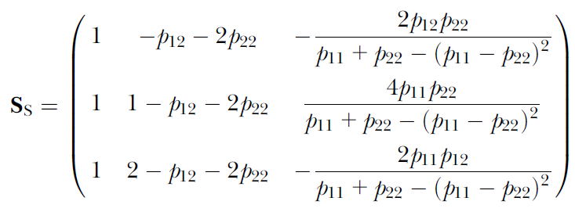
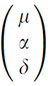
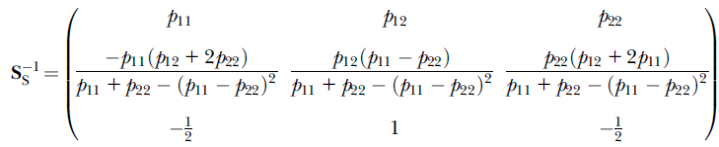
Population-referenced genetic effects
G = S E
E=
E = S⁻¹ G
What if
p₁₁ = p₂₂?
E₂ = (S₂)⁻¹ S₁ E₁
Alleles are “good” if the mean (reference) is improved when they replace others
Álvarez-Castro and Carlborg 2007 Genetics 176
Notes:
Interactions (dominance) make the additive effects to depend on the population frequencies. Note that if p11=p22, this dependency collapses to the same as the functional case

Slide 17
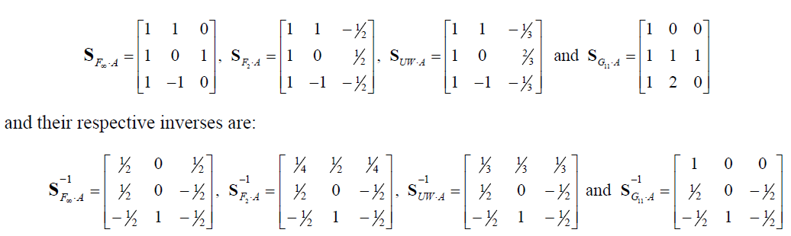
Genetic-effect design matrices: S
Decomposition of genotypic values:
Definition of genetic effects:
F∞ Fisher’s yardstick
UWR: Cheverud’s yardstick
F₂ Mendel’s cross
Individual-referenced
Infinitesimal model: Genetic architecture with many independent (additive) effects on the phenotype (nothing to see with F∞)
Notes:
Contradictions of the F_ininity:
-Not initially a population-wise expression but a yardstick
-As a population expression, it does not enable computation of dominance
-Possible confusion with the infinitesimal model

Slide 18
Variance decomposition
Recall the graphical interpretation: we need three points for a regression
α₂₂
1
α₁₂
α₁₁
2α
Genotypic value
Population-reference genetic effects and variance decompositions can be computed using population-referenced models with the three genotypes present
δ₁₁
0
0
1
2
A₁A₁
A₁A₂
A₂A₂
Genotype
P = G + E
P = A + D + E
V_{P} = V_{G} + V_{E}
V_{P} = V_{A} + V_{D} + V_{E}

Slide 19
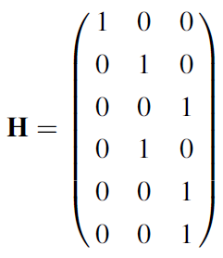
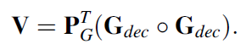
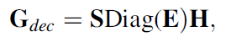
Variance decomposition
Recall the graphical interpretation: we need three points for a regression
α₂₂
1
α₁₂
α₁₁
2α
Genotypic value
Population-reference genetic effects and variance decompositions can be computed using population-referenced models with the three genotypes present
δ₁₁
0
0
1
2
A₁A₁
A₁A₂
A₂A₂
Genotype
Variance decomposition with the matrix notation:

Slide 20
Heritability
• The degree of genetic determination of a trait in a population can be measured as H² = V_{G} / V_{P} , and it is called the broad-sense heritability

Slide 21
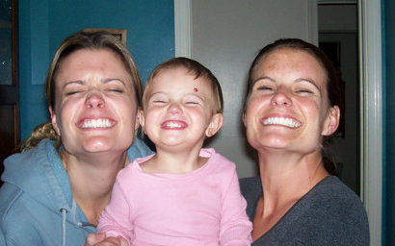
Heritability: what do we inherit?
It easily calls our attention that relatives resemble each other more than the average within a population
http://www.wunderground.com/wximage/viewsingleimage.html?mode=singleimage&handle=seflagamma&number=400
This resemblance is due to sharing alleles with Mendelian inheritance

Slide 22
Heritability
• The degree of genetic determination of a trait in a population can be measured as H² = V_{G} / V_{P} , and it is called the broad-sense heritability
• The degree of genetic determination of a trait is not completely informative about how much related individuals resemble each other on average in the population, because related individuals share alleles rather than genotypes
• For this purpose, a variance of allelic effects is required instead so that we can define h² = V_{A} / V_{P} , which will be called the narrow-sense heritability (of a trait in a population)
• Thus, again, beyond P = G + E we need to decompose the genotypic values to get P = A + D + I + E , but the previous individual-referenced decomposition does not hold in the context of a population

Slide 23
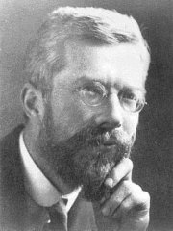
Simple application
Indeed, Fisher’s original paper was entitled “The covariance between relatives on the supposition of Mendelian inheritance”
Result: The variances of the average additive effects of Mendelian factors determine the resemblance between relatives in a population
Let us see this through a simple application:
Measure resemblance (phenotypic covariance) between half-sibs
Estimate of the additive variance: V_{A}
Predicted resemblance between parents and offspring
Predicted selection response, conditioned by the heritability: R= h² S, h² = V_{A} / V_{P}

Slide 24
The breeder’s equation
Since parents pass alleles to their offspring (and not genotypes), their resemblance relies on the additive effects of the alleles only
At the population level, the average resemblance is given by the (statistical) average effects
The response to selection relies in its turn on how much the offspring resemble their (selected) parents , thus, it is the product of the (narrow-sense) heritability and the selection differential, R = h² s
This is a very practical tool that, very importantly, worked out very well even before we knew that the genes were in the DNA!
But, beyond a black-box, top-down approach, today we are also aware that the heritability is defined from the effects of the alleles within the genes (bottom-up approach)

Slide 25
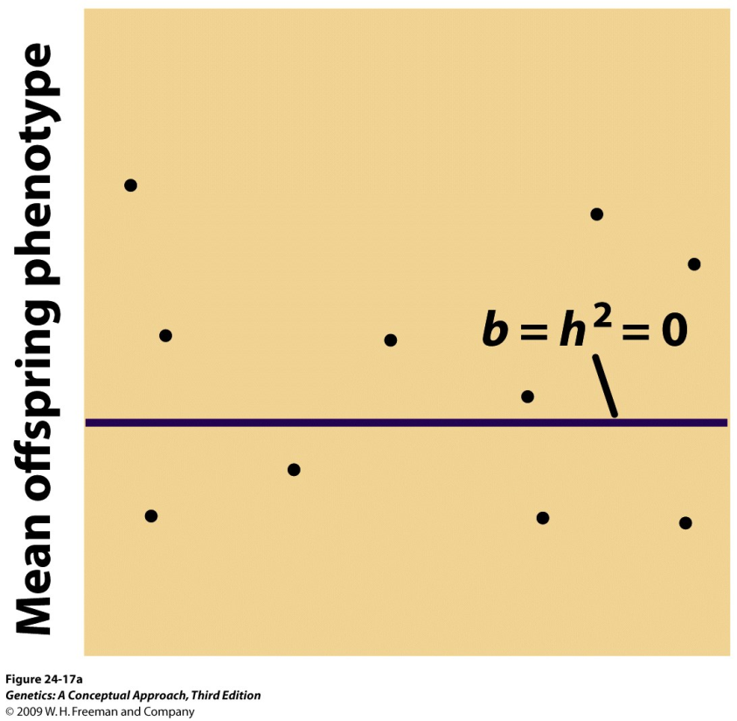
Regression towards mediocrity
If all variation is due to environmental effects, the regression towards mediocrity will actually be a complete regression to the mean
Pierce 2014
Mean parental phenotype
(Johanssen’s experiment)
Non inheritable differences

Slide 26
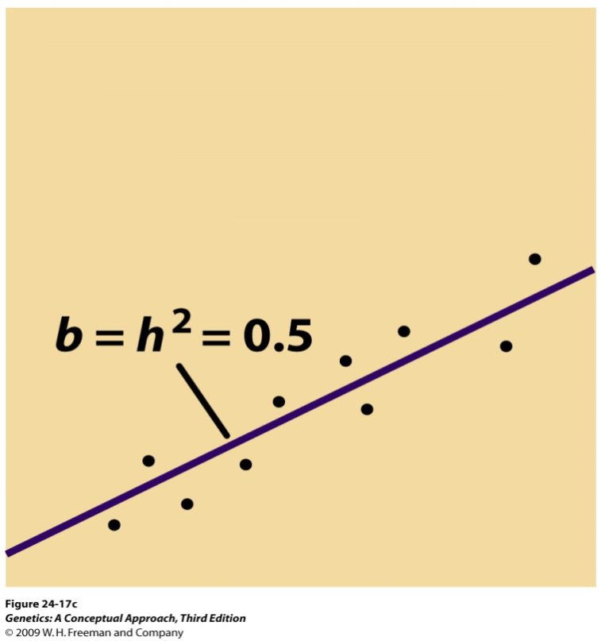
Regression towards mediocrity
If, on the contrary, there also exists genetic variance, the regression is not expected to be complete
Pierce 2014
Mean parental phenotype
Question: Why the total variance also changes?
Inheritable differences

Slide 27
Regression towards mediocrity
The selected individuals have different genetic material (properties)
Some individuals may have a genetic propensity towards higher phenotypes, but environmental effects made them shorter
Other individuals may have genetic propensity towards higher phenotypes, but environmental effects made them higher
The second option is more likely, and this is what explains the regression towards mediocrity
Interactions work analogously!

Slide 28
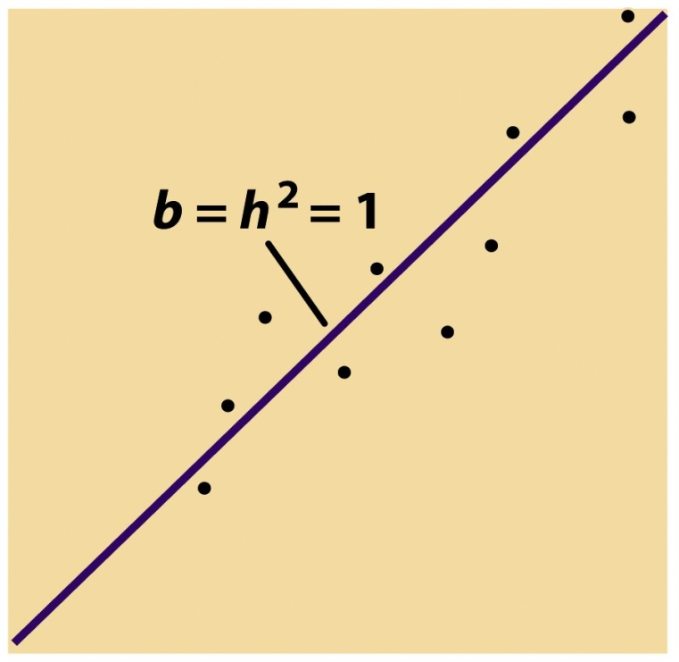
Regression towards mediocrity
Without environmental effects (or gene interactions) there would not be any “regression” at all
(Pierce, 2014)
Mean parental phenotype
(Nilsson-Ehle’s experiment)
Inheritable differences

Slide 29
Variance decomposition
We have just seen that differences in phenotype (phenotypic variance) are due both to genetic and environmental effects, which causes a regression towards mediocrity after selection
Expression P=G+E accounts for the partition of the phenotype into its genetic and environmental influences
When taking variances on that partition we get: V_{P}=V_{G}+V_{E} (phenotype variance partition, into variance caused by genetic and environmental effects)
The proportion of genetic variance in the phenotypic variance is the broad sense heritability:
H² = V_{G} / V_{P}
The regression towards mediocrity is actually determined by the narrow sense heritability:
Diferenzas herdábeis
h² = V_{A} / V_{P}
Notes:
Broad sense heritability -> Genetic determination of a trait (in a population)
Narrow sense heritability -> Resemblance between relatives -> Response to selection

Slide 30
Heritability
What does the heritability depend upon?
h² = V_{A} / V_{P}
(R = h² S)
Estimation
Computation
Phenotypes
Genotype freqs
GP map
Phenotypes
Relatedness
V_{A}
Top-down approach
Bottom-up approach
(black box)
(changing reference makes sense)

Slide 31
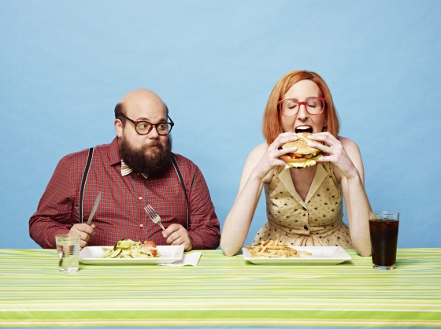
Epistasis
The obesity gene exists!

Slide 32
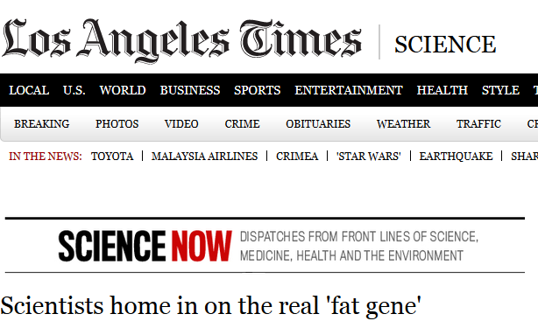
By Melissa Healy March 13, 2014, 6:00 a.m.
If you're a student of fat - and who isn't these days? - you know that the FTO gene is the gene thought to be most responsible for some people's inherited propensity to become obese. Well, forget that.
A multinational group of geneticists has discovered that, more likely, the real obesity gene is named IRX3, and it is very far from the FTO gene - or would be, if DNA were to be stretched out in linear fashion instead of coiled up like a skein of yarn.

Slide 33
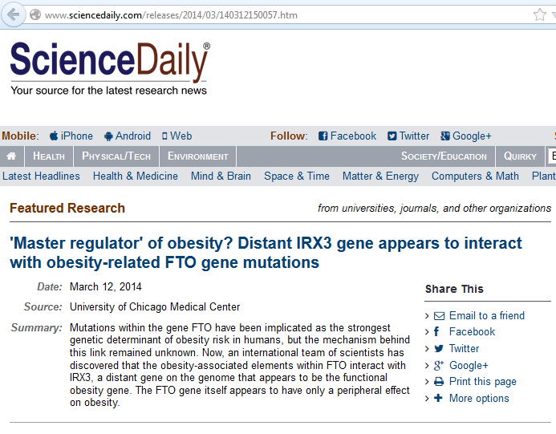

Slide 34
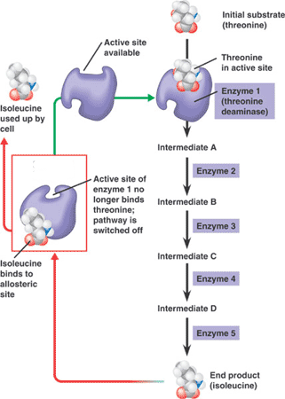
Do we aim to map pathways?
We must bear in mind that gene mapping is aimed to detect genetic variability affecting the trait value
It would not be surprising that a very important enzyme in a pathway is under strong purifying selection (very little genetic variation)
On the other hand, regulatory regions are also loci and can be genetically variable
https://www.quia.com/jg/2466359list.html

Slide 35
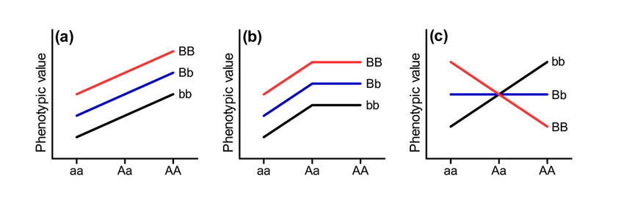
Example of pairwise epistasis
Additive
Dominance
Epistasis
Question: What happens if the three lines coincide? And if the three lines are horizontal?
Task: Draw the diagram of complete dominance in both loci (and no epistasis between them)
Notes:
The genetics of infectious disease susceptibility: Has the evidence for epistasis been overestimated?

Slide 36
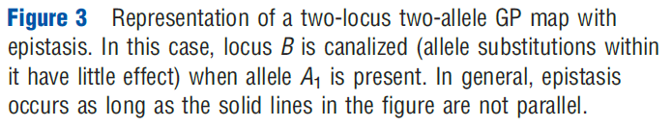
Example of pairwise epistasis
Kliman (Ed.) 2016 Encyclopedia of Evolutionary Biology. Vol 2 Quantitative Genetics. Elsevier
B₂B₂
Genotypic value
B₁B₂
Task: Reset this figure with genotypes for locus B in the horizontal axis
B₁B₁
A₁A₁
A₁A₂
A₂A₂
Genotype at locus A
It is not straightforward to figure out what implications epistasis has by looking at the genotypic values... even with only two biallelic loci!
(We should better look at the values the interaction effects take)
Notes:
We thus need to look at the values of the genetic effects for epistasis.

Slide 37
Simple maths: Matrix notation
G = S_{R1} E_{R1}
This enables straightforward inversion and change of reference:
Effects from genotypic values:
From any reference point:
Change of reference equating G: E_{R2} = (S_{R2})⁻¹ S_{R1} E_{R1}
Álvarez-Castro and Carlborg 2007 Genetics 176
Notes:
Notice that the expression of S^-1 from any reference point does not make the genetic effects change when changing the reference

Slide 38
Multiple alleles
The matrices for several alleles can also be built easily, although each new allele brings more genetic effects to the genetic system
All these expressions are 21st century genetic modelling
Question: Given that the (non population-related) genetic effects are biologically meaningful, why were they considered just as a yardstick?
Yang and Álvarez-Castro 2008 CurrTopGen 3 Álvarez-Castro and Yang 2011 Genetica 139

Slide 39
Several loci
Computation of the S matrix using the Kronecker product (using the reference of he heterozygote in B):
Expression for two loci with epistasis:
Thus, there is a straightforward way of extending the individual-referenced (also the population-referenced) models of genetic effects in matrix notation G=SE to an arbitrary number of loci with arbitrary epistasis

Slide 40
Patterns of epistasis
Additive
Dominance
Epistasis
This case of epistasis actually comprises only additive-by-additive interactions
This particular kind of interactions may generate this pattern of sign-epistasis, or also sinergistic and antagonistic epistasis
Task: Can you figure out the diagram or sinergistic epistasis?
Notes:
First individual-referenced model

Slide 41
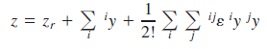
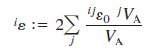
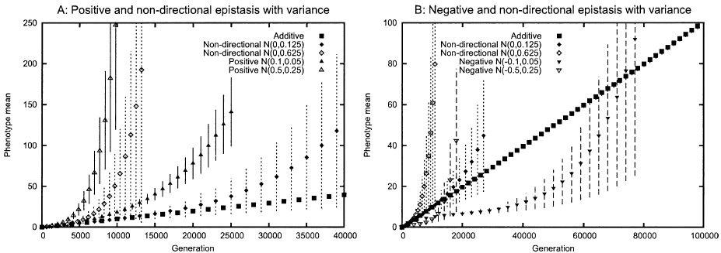
Patterns of epistasis
Multilinear model (not general)
Directional epistasis index
Hansen et al. 2006 Evolution 60
The directional epistasis index can be inferred from a general GP map (from NOIA)
Le Rouzic and Álvarez-Castro 2008 Evolutionary Bioinformatics 4
Notes:
First individual-referenced model

Slide 42
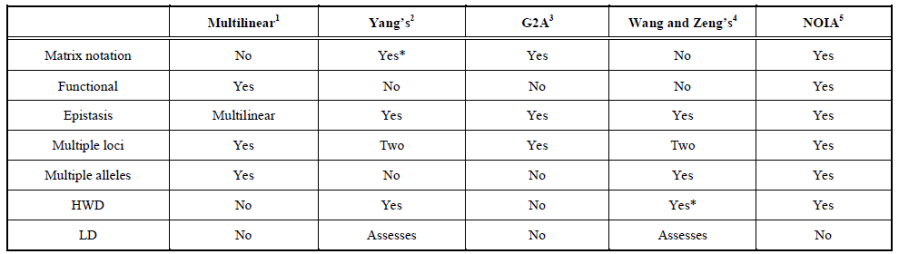
Appropriate models of genetic effects required!
We need models that account for properties related to both genetic architecture (e.g. arbitrary epistasis) and population composition (e.g. HWD)
We still cannot properly estimate genetic effects under LD
Álvarez-Castro 2012 Current Genomics 13

Slide 43
Orthogonality
When population-referenced models of genetic effects are orthogonal, not only the effects are defined in a way that has a biological meaning (orthogonal variance decomposition), but also non significant effects can be removed without modifying the remaining effects, enabling proper model selection
For getting to an orthogonal model of genetic effects in the face of LD, the Kronecker product is useless and the regression has to be solved in one shot (rather than locus by locus)
Notes:
Interactions (dominance) make the additive effects to depend on the population frequencies. Note that if p11=p22, this dependency collapses to the same as the functional case

Slide 44
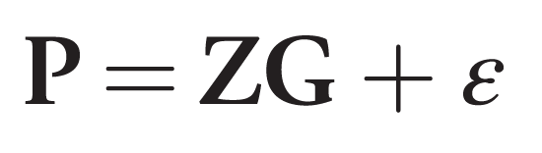
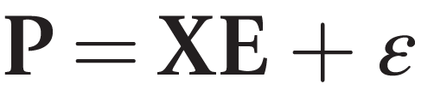
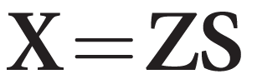
Estimation of genetic effects
Z -> Incidence matrix
S -> Genetic-effects design matrix
X -> Regression matrix
We expect to deal with missing genotype information, which makes imputation regression (IMI) convenient since it still allows for orthogonal estimation of genetic effects
(Nettelblad et al. 2012 OJG 2)

Slide 45
Estimation of genetic effects
Toy example
 | Genotype probabilities
 | 11 | 12 | 22
 | ¾ | ¼ | 0
 | 0 | ¾ | ¼
 | 0 | ½ | ½
 | 1 | 0 | 0
 | 0 | 1 | 0
 | 0 | 1 | 0
 | 0 | 0 | 1
 | = ¼ | = ½ | = ¼
∑(column) ∕ 7
F₂

Slide 46
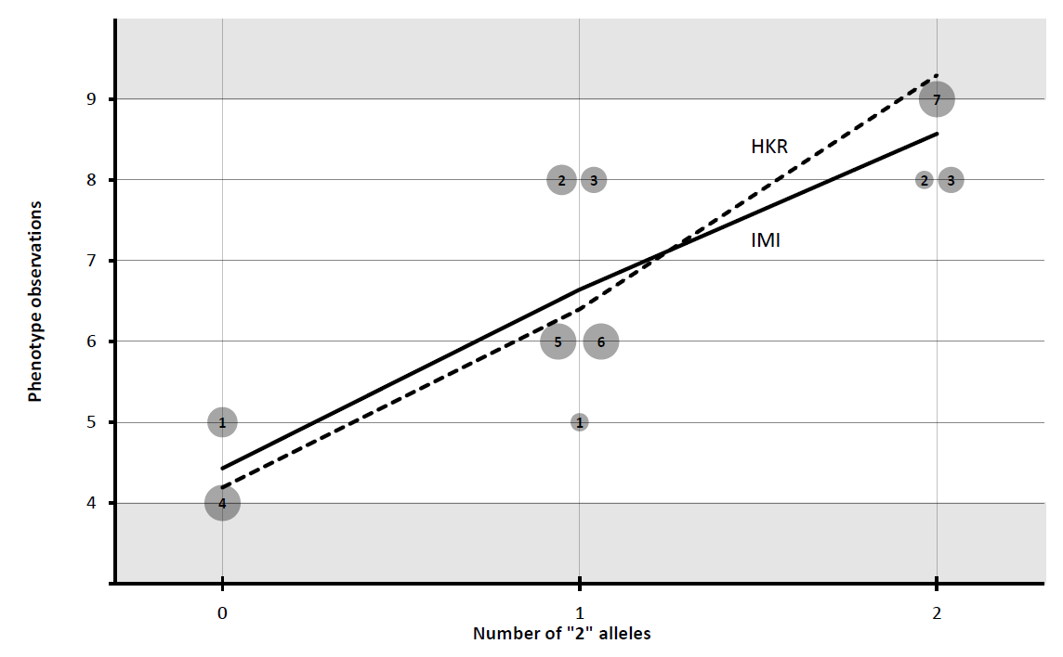
Estimation of genetic effects
Toy example
G* = Z_{HKR}·G + ε

Slide 47
Estimation of genetic effects
Toy example
G* = Z_{IMI}·G + ε

Slide 48
Estimation of genetic effects
Toy example
 | Model of genetic effects (S-matrix)
Estimates | Full F₂ model | Reduced F₂ models additive dominance
µ | 6.57 | 6.57 | 6.57
α | 2.55 | 2.52 | −
δ | -0.34 | − | 0.22
Explained Variance | 2.6305 | 2.6118 | 0.0079
Sum |  | 2.6197
G* = Z_{HKR}·S_{F2}·E + ε

Slide 49
Estimation of genetic effects
Toy example
 | Model of genetic effects (S-matrix)
Estimates | Full F₂ model | Reduced F₂ models additive dominance
µ | 6.57 | 6.57 | 6.57
α | 2.07 | 2.07 | −
δ | 0.14 | − | 0.14
Explained Variance | 2.1505 | 2.1454 | 0.0051
Sum |  | 2.1505
G* = Z_{IMI}·S_{F2}·E + ε

Slide 50
Estimation of genetic effects
Toy example
 | Model of genetic effects (S-matrix)
Estimates | Full F₂ model | Reduced F₂ models additive dominance
µ | 6.57 | 6.57 | 6.57
α | 2.07 | 2.07 | −
δ | 0.14 | − | 0.14
Explained Variance | 2.1505 | 2.1454 | 0.0051
Sum |  | 2.1505
For obtaining orthogonal estimates of genetic effects we need to:
- Choose the right regression method (incidence matrix, Z)
- Choose the right model of genetic effects (genetic-effects design matrix, S)

Slide 51
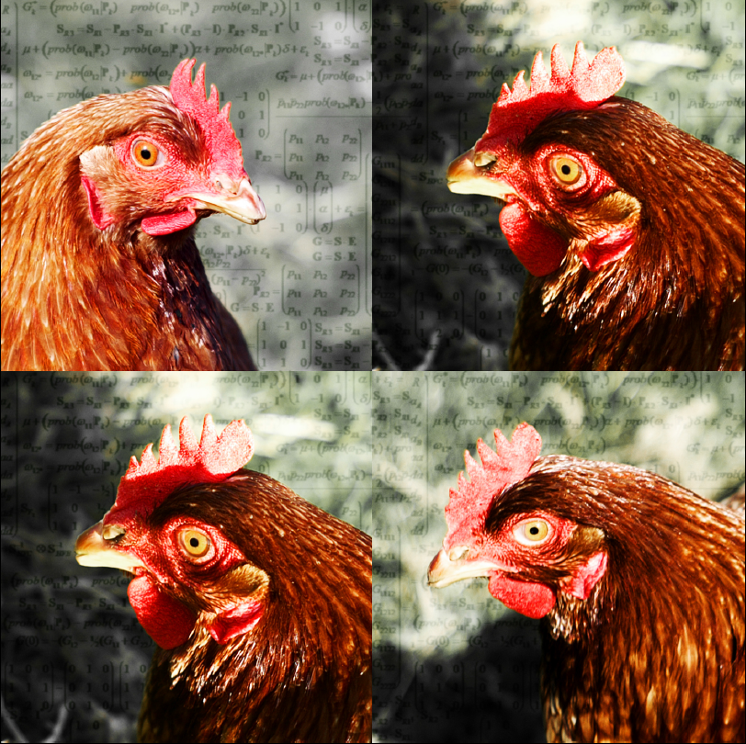
Evolutionary importance of interactions

Slide 52
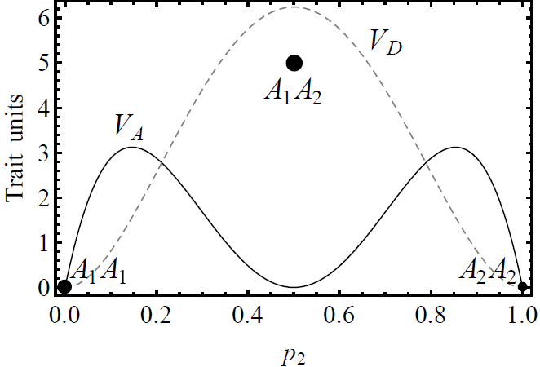
Interpreting variance decomposition
The additive variance is a statistic that indicates the amount of trait variance that is available for selection to change the population mean in a one-generation step (trait is assumed to be fitness)
The interaction variances indicate the amount of trait variance that is due to the underlying genetics but is not available for selection to change the population mean in a one-generation step
The additive variance (on fitness) is zero at equilibrium
The interaction variances being small does not imply that the corresponding genetic effects do not exist or are unimportant
There is no direct link between the (functional) genetic effects and their corresponding (statistical) variance components
Moore and Williams (Eds.) 2015 Epistasis: Methods and Protocols. Springer

Slide 53
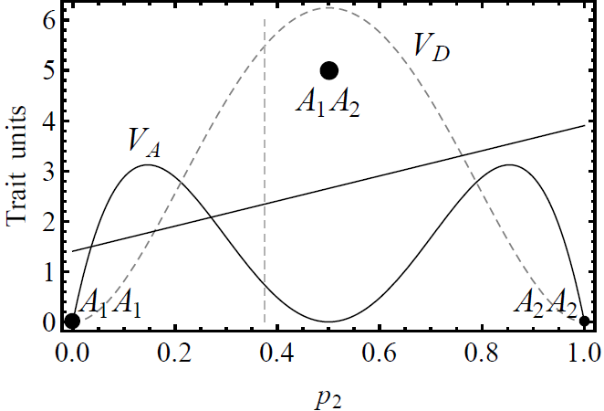
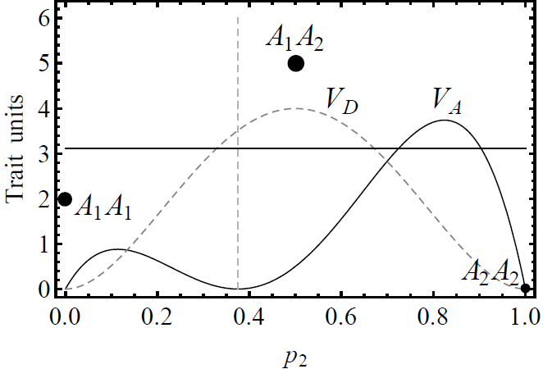
Beware the meaning!
When interactions are present, individual- and population-referenced genetic effects behave very differently; they just mean different things!
Genetic architecture -> Individual-referenced genetic effects
Álvarez-Castro 2014 Frontiers in Ecology and Evolution 2
Notes:
Related to the question of why are there population-unrelated and –related effects

Slide 54
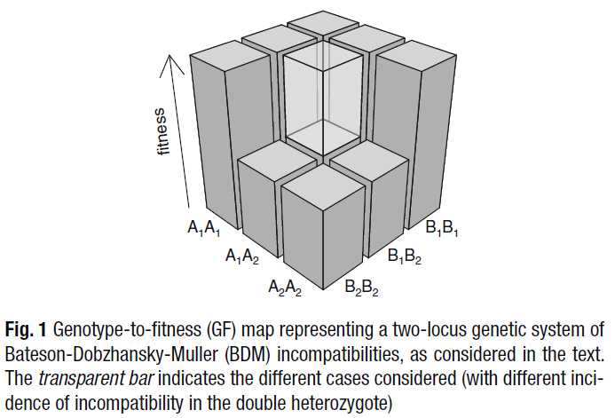
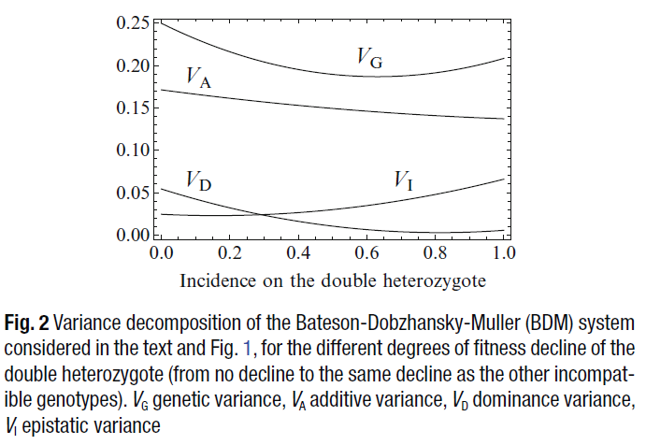
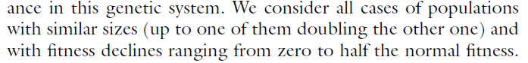
Epistasis and epistatic variance
The amount of epistatic variance in a population is not an index of the evolutionary importance of epistasis
Moore and Williams (Eds.) 2015 Epistasis: Methods and Protocols. Springer

Slide 55
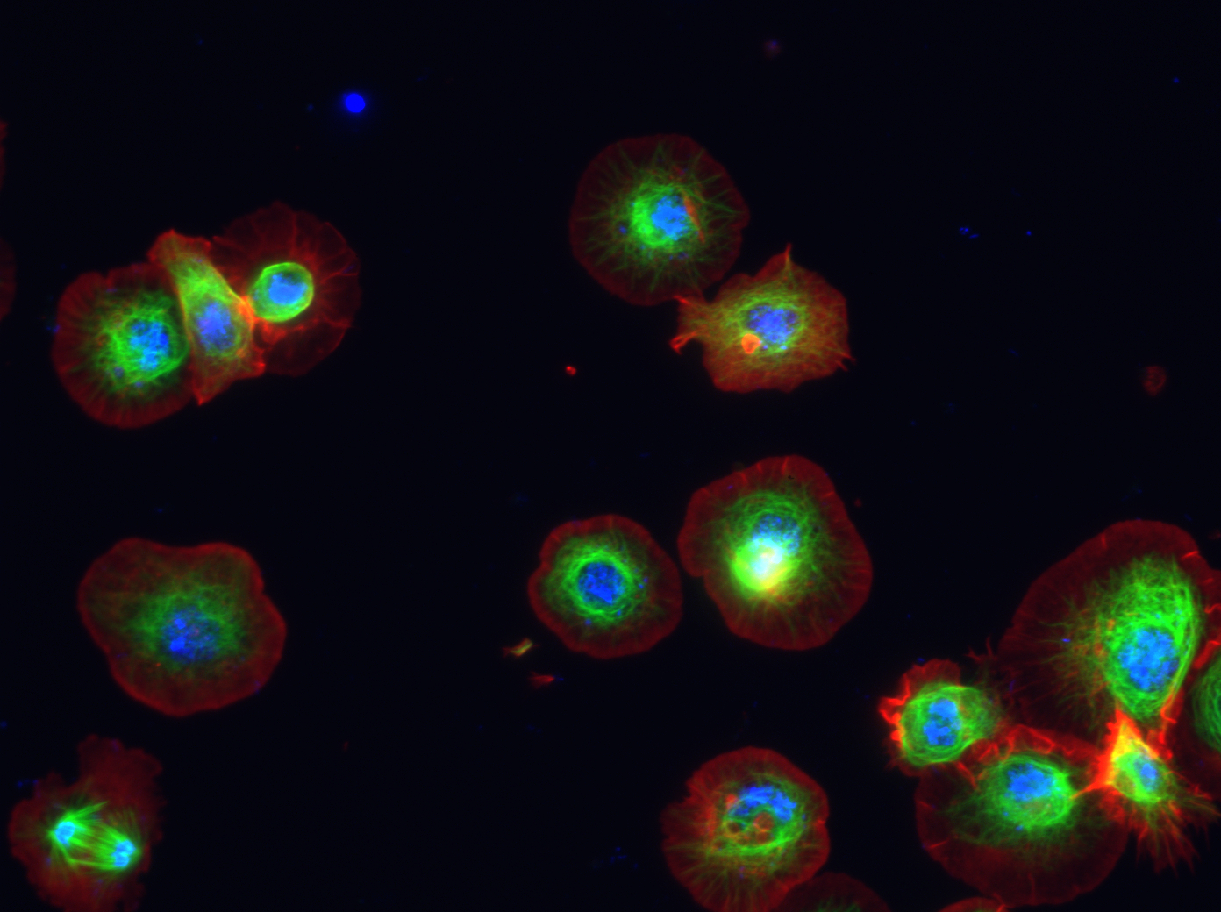
Human ACP1 polymorphism
Red cell acid phosphatase: enzime related to growth
Three allelic variants in European human populations: A, B, C
Enzime activity and enzyme inhibition are additive
Genotypic frequencies display departures from Hardy-Weinberg
http://cmckb.cellmigration.org/report.cgi?report=prot_overview&gene_id=52
How then can we explain the maintenance of the polymorphism?

Slide 56
Human ACP1 polymorphism
DATA
Three alleles segregating at this locus in Europe
Large sample of genotypes of a German population.
Phenotypes also known, but they are additive (do not explain the polymorphism)
METHODS
Explicit expression of the multiallelic decomposition of the genetic variance with departures from the Hardy-Weinberg proportions
Minimizing the additive variance as a function of the fitness values for checking whether the frequencies are in accordance with a polymorphic equilibrium (Mathematica)
RESULTS
This way, a GP (actually GF) can be estimated from frequencies, assuming they are equilibrium frequencies
Appropriate models of genetic effects needed (NOIA)

Slide 57
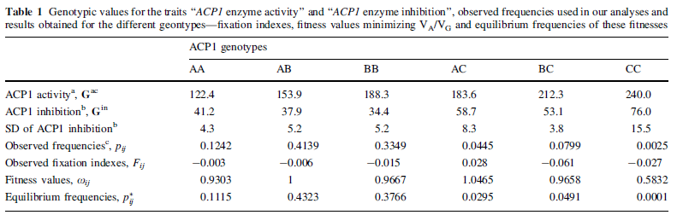
Human ACP1 polymorphism
Deterministic simulations were run for double checking that the frequencies correspond to the equilibrium given by the estimated fitnesses
Álvarez-Castro and Yang 2011 Genetica 139

Slide 58
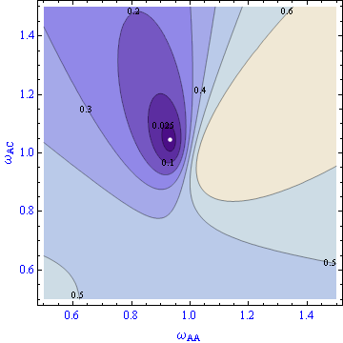
Human ACP1 polymorphism
The frequencies are actually in accordance with a polymorphic equilibrium
The fitness values obtained fit predictions based on physiological observations
The explicit expression of the variance decomposition enables us to also easily plot the V_{A}/V_{G} ratio
Small changes in the fitness values may be associated to dramatic increases of the V_{A}/V_{G} ratio
This actually is biologically reliable since AA is supposed to be penalized through fetal macrosomia and we now have pregnancy monitoring and Caesarean sections
V_{A}/V_{G}
The variance decomposition can thus be used to obtain fitness estimates
It is important to keep in mind that what we arbitrarily define as phenotype (or the selection regime on it) may not help us understand selection
Moore and Williams (Eds.) 2015 Epistasis: Methods and Protocols. Springer

Slide 59
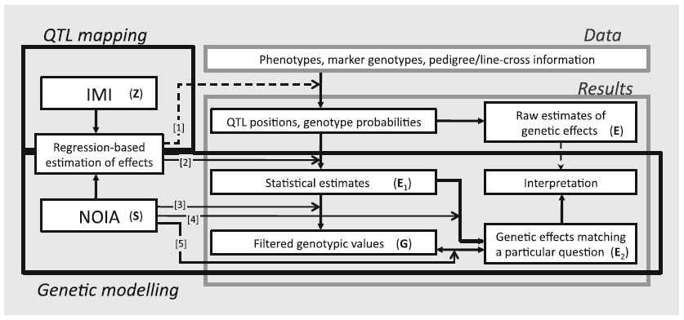
Mapping interaction effects
Rifkin (Ed.) 2012 QTL: Methods and Protocols. Springer

Slide 60
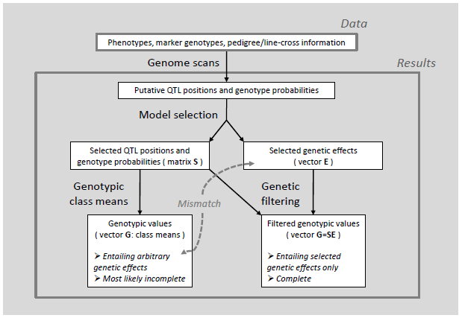
Genetic filtering
Álvarez-Castro 2012 Current Genomics 13

Slide 61
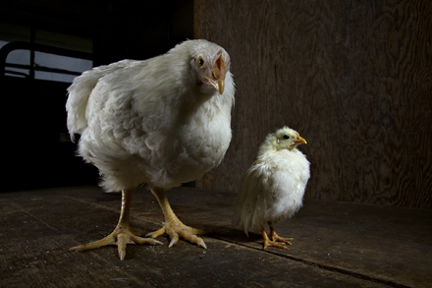
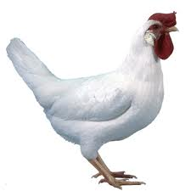
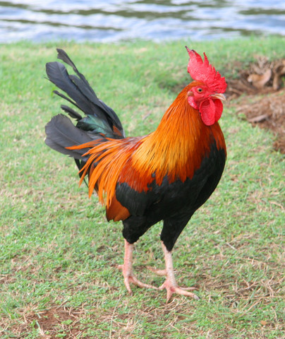
Growth rate of chickens
QTLs found in two crosses:
domestic White Leghorn Layer and wild ancestral Red Junglefowl
High and Low selected domestic lines (the “Virginia lines”)
QTL analysis was performed both for additive and pairwise epistatic effects and several loci were mapped--four-locus networks considered here

Slide 62
Domestication process
The differentiation among the three genotypes for this locus shows up earlier in the genetic background of the domestic line, supporting the argument that the adult physiological stage is attained earlier by domestic chicken.
Le Rouzic et al. 2008 Genetics 179

Slide 63
Domestication process
The genotypic values were obtained using only the genetic effects found to be significant in the study (applying genetic filtering with NOIA)
How much can we trust this estimate of the GP map anyway?
Le Rouzic et al. 2008 Genetics 179

Slide 64
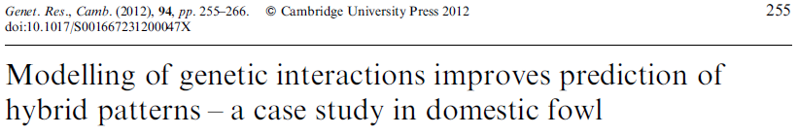
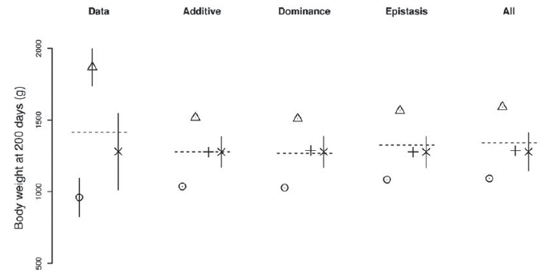
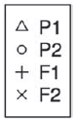
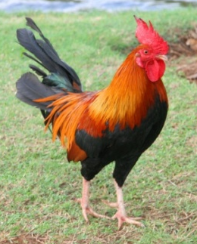
Do QTL enable prediction?
QTL provide prediction and epistasis seems to be crucial to this regard

Slide 65
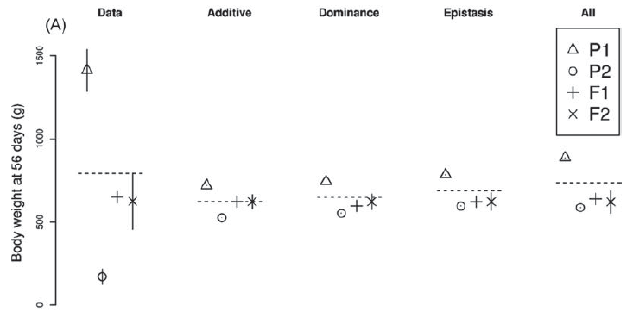
Do QTL enable prediction?
QTL provide prediction and epistasis seems to be crucial to this regard

Slide 66
Do QTL enable prediction?
The highest genotype has a low-line allele!
(“Good” alleles are lost during selection)

Slide 67
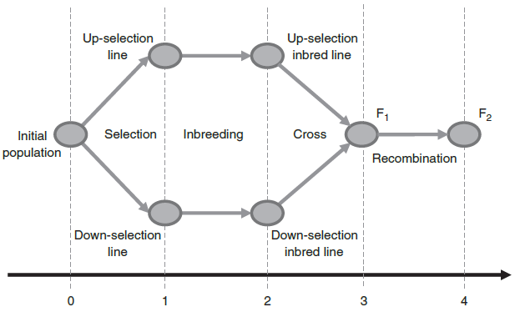
“Low” alleles in a high line?
The classical setting for QTL analysis tries to maximize the differences between pairs of alleles fixed in alternative lines
What is needed is being able to distinguish the DNA coming from each of the lines crossed (with genetic markers), but non inbreeding may obscure the effects
Kliman (Ed.) 2016 Encyclopedia of Evolutionary Biology. Vol 2 Quantitative Genetics. Elsevier

Slide 68
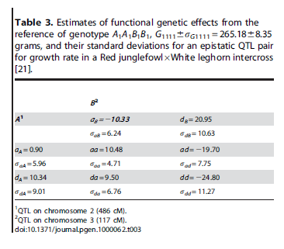
Domestication process
Domestic alleles at both loci show overdominance under the wild background at the other locus.
Epistasis (aa) makes the double domestic homozygote to overcome the heterozygotes, which can be an explanation for the fixation of the domestic alleles in the domestic line
Álvarez-Castro et al. 2008 PLoS Genetics 4(5)
The key point is obtaining individual-referenced genetic effects with the ancestral (wild) genotype as reference

Slide 69


Evolution of the variance partition
W x D Up-Directional Selection
It can be tricky to interpret the boosts of additive variance as “conversions” of interaction into additive variance
Interestingly, selecting upwards the same locus remains variable (sign epistasis on overdominance)
Moore and Williams (Eds.) 2015 Epistasis: Methods and Protocols. Springer

Slide 70


Evolution of the variance partition
W x D Stabilizing Selection
The dynamics of the variance components along selection processes can be very complex
In particular, the additive variance is not supposed to only experience boosts, but it can actually virtually vanish temporarily
This is actually an example of phenotypic stasis, which could be longer with more epistatic loci involved

Slide 71


Evolutionary plateaus and stasis
MUTATION
An evolutionary plateau (maybe to the level of stasis) actually occurred during the selection process of the QTL mapping experiment
Le Rouzic and Álvarez-Castro 2016 The Am Nat (In press)

Slide 72

Plateaus with two biallelic loci

Slide 73




Historical perspective
Kliman (Ed.) 2016 Encyclopedia of Evolutionary Biology. Vol 2 Quantitative Genetics. Elsevier
Production
Systems biology
http://funwithbulls.wordpress.com/category/dairy-genomics/ Ernesto Gonzásez Torterolo e Náchok http://theteterszone.tripod.com/catapultay.html
Demographic history

Slide 74


The black box of genetic effects
Quantitative Genetics
1990s
QTLs
Evlotionary Quantitative Genetics
1900s
1970s
Neutral markers
Footprint of selection
Population Genetics
2000s

Slide 75
One century after Fisher (1918)
Fisher (1918) established genetic modelling with a black-box approach that enabled instant applicability of quantitative genetics to plant and animal breeding
This occurred about two decades before the DNA was found to be the molecule of inheritance, three decades and a half before its structure was revealed, seven decades before the advent of gene mapping
While the black-box approach will keep on providing useful results, gene-mapping proves to be a key tool to open new possibilities for improving our understanding of the evolutionary processes
For carrying on this line of work, we need to attain a satisfactory update of the models of genetic effects with which Fisher established the field of quantitative genetics (and to promote a creative use of them)

Slide 76

Google: noia genetic effects model
Google: noia r package

Slide 77


